Slide 1
Coder / De-Coder – Jan 11
Agenda
Course Selections
Visit from Mrs. K-M
Selections DUE TODAY
Marks Spreadsheet
Review / Complete missing work
Module B.7 Coder / De-Coder
Complete by Tomorrow
Upcoming
Monday: Summative Pre-Work begins
See January Schedule

Slide 2

Substitution Code
Google “Substitution Code”

Slide 3
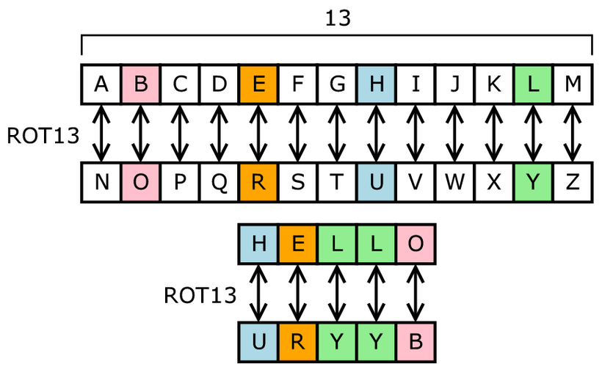
Substitution Code
Google “Substitution Code”

Slide 4
January Calendar
Date | ICS20
Mon Jan 7 | Heroes Trade Show
Tue Jan 8 | Mod B.7 Python Coder / De-Coder
Wed Jan 9 | Mod B.7 Python Coder / De-Coder
Thu Jan 10 | Mod B.7 Python Coder / De-Coder
Fri Jan 11 | Mod B.7 Python Coder / De-Coder
Mon Jan 14
Tue Jan 15
Wed Jan 16
Thu Jan 17
Fri Jan 18 | Prep for Summative - Review
Mon Jan 21 | Summative Part 1 – Computer Concepts
Tue Jan 22 | Summative Part 2 – Programming
Wed Jan 23 | Summative Part 2 – Computers & Society

